Slide 1
Data Structures & Algorithms (CSC-214)
Queues – Array based implementation

Slide 2
Queues
Queue is First-In-First-Out (FIFO) data structure
First element added to the queue will be first one to be removed
Queue implements a special kind of list
Items are inserted at one end (the rear)
Items are deleted at the other end (the front)

Slide 3
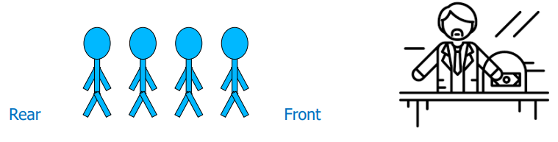
Queue – Analogy (1)
A queue is like a line of people waiting for a bank teller
The queue has a front and a rear
New people must enter the queue at the rear
An item is always taken from the front of the queue

Slide 4
Queues – Examples
Billing counter
Booking movie tickets
Queue for paying bills
A print queue
Vehicles on toll-tax bridge
Luggage checking machine
And others?

Slide 5
Queues – Applications
Operating systems
Process scheduling in multiprogramming environment
Controlling provisioning of resources to multiple users (or processes)
Communication software
Hold messages/packets in order of their arrival
Messages are usually transmitted faster than the time to process them
The most common application is in client-server models
Multiple clients may be requesting services from one or more servers
Some clients may have to wait while the servers are busy
Those clients are placed in a queue and serviced in the order of arrival

Slide 6
Basic Operations (Queue ADT)
MAKENULL(Q)
Makes Queue Q be an empty list
FRONT(Q)
Returns the first element on Queue Q
ENQUEUE(x,Q)
Inserts element x at the end of Queue Q
DEQUEUE(Q)
Deletes the first element of Q
EMPTY(Q)
Returns true if and only if Q is an empty queue

Slide 7
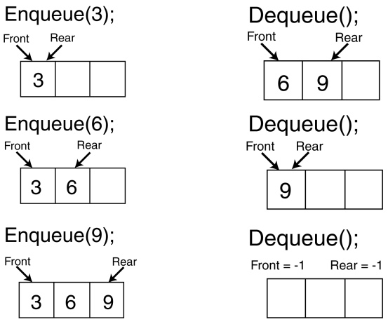
Enqueue And Dequeue Operations

Slide 8
Implementation
Static
Queue is implemented by an array
Size of queue remains fix
Dynamic
A queue can be implemented as a linked list
Expand or shrink with each enqueue or dequeue operation

Slide 9
Array Implementation
Use two counters that signify rear and front
When queue is empty
Both front and rear are set to -1
When there is only one value in the Queue
Both rear and front have same index
While enqueueing increment rear by 1
While dequeueing, increment front by 1

Slide 10
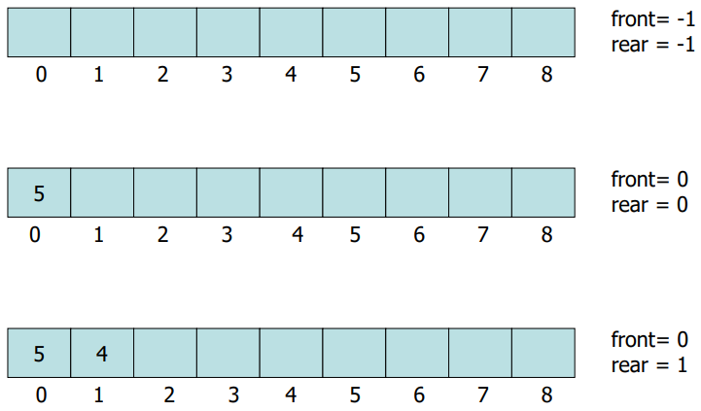
Array Implementation Example (1)

Slide 11
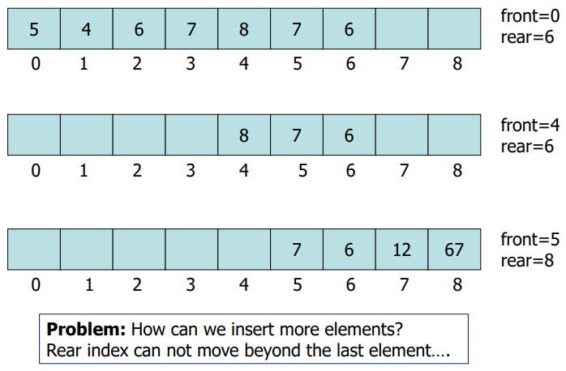
Array Implementation Example (2)

Slide 12
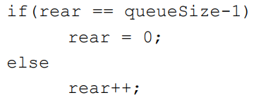

Using Circular Queue
Allow rear to wrap around the array
Alternatively, use modular arithmetic

Slide 13
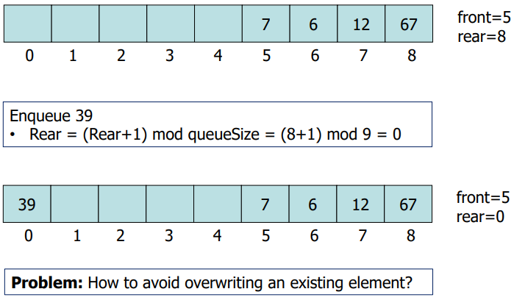
Example

Slide 14
How to Determine Empty and Full Queues?
A counter indicating number of values/items in the queue
Without using an additional counter (only relying on front and rear)

Slide 15
Array-based Implementation

Slide 16
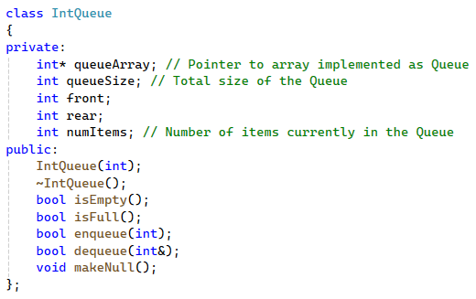
Array Implementation – Code (1)

Slide 17
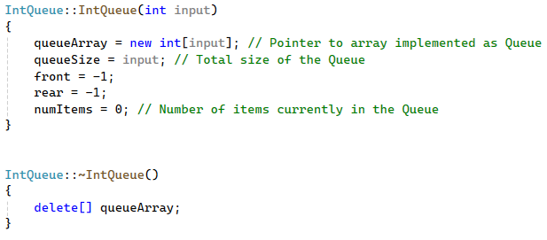
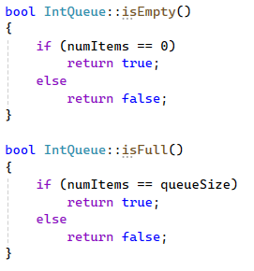
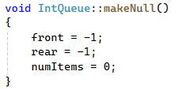
Array Implementation – Code (2)

Slide 18
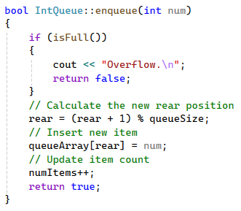
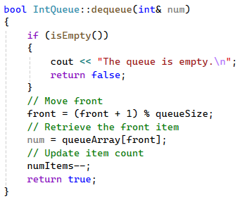
Array Implementation – Code (3)

Slide 19
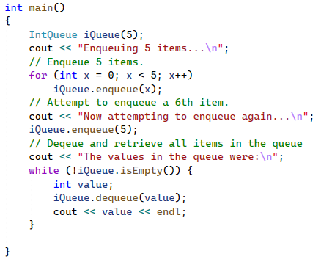
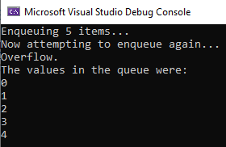
Using Queues

Slide 20
Alternative Array-based Implementation

Slide 21
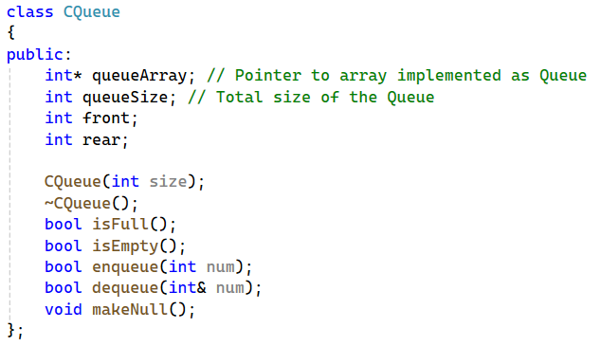
Alternative Implementation – Code (1)

Slide 22
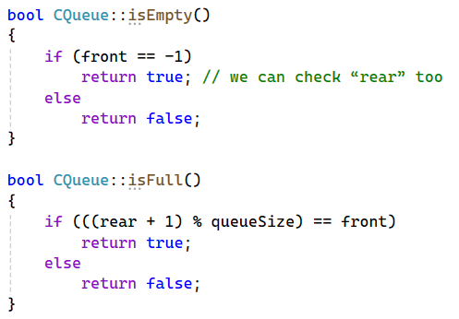
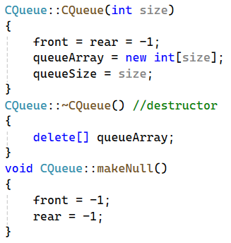
Alternative Implementation – Code (2)
Any Questions?

Slide 23
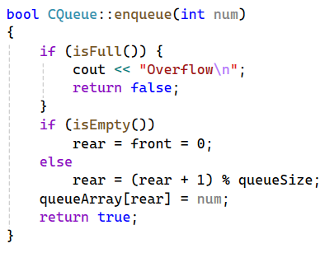
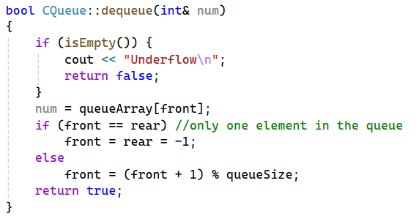
Alternative Implementation – Code (3)

Slide 24
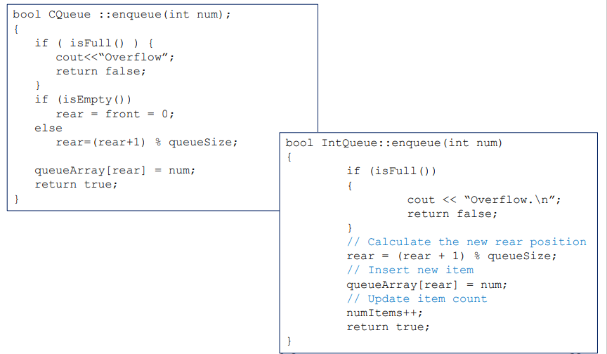
Comparison: enqueue Operation

Slide 25
Any Questions?

